Slide 1
UE21CS7A1B – Project Work Phase – 2
SEMESTER - VI
END SEMESTER ASSESSMENT
Project Title : Heart Disease Prediction Using ML Models
Project ID : PWPG22PH01
Project Guide : Dr . Priyanka H (Associate Professor, CSE)
Student Name : SHARADA.A.
1

Slide 2
Outline
Abstract
Team Roles and Responsibilities.
Summary of Requirements and Design (Phase - 1)
Summary of Methodology / Approach (Phase - 1)
Design Description
Modules and Implementation Details
Project Demonstration and Walkthrough
Test Plan and Strategy
Results and Discussion
Lessons Learnt
Conclusion and Future Work
References
2

Slide 3
Abstract
Include the following,
This project is mainly dealing with heart disease problems of patients. In this it is to identify the disease in patients,whether he/she is having heart disease or not.This is can be identified by using ML models also using confusion matrix and to find the accuracy of the model by using comparison study.
3

Slide 4
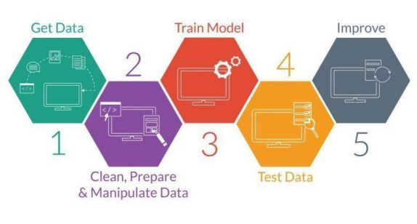
Team Roles and Responsibilities
Fig: step by step procedure of flow of project
Courtesy:google
4

Slide 5
Summary of Requirements and Design
Comparison study of proposed model with another model by using heart disease dataset.
After getting highest accuracy will be considered as resultant model.
Again by deploying these models into confusion matrix to get perfect accuracy and in that the model getting highest accuracy percentage.
By checking the total size of dataset and by having exact count to people having disease and people not having disease through dataset.
XGBOOST will be used to predict the disease.
5

Slide 6
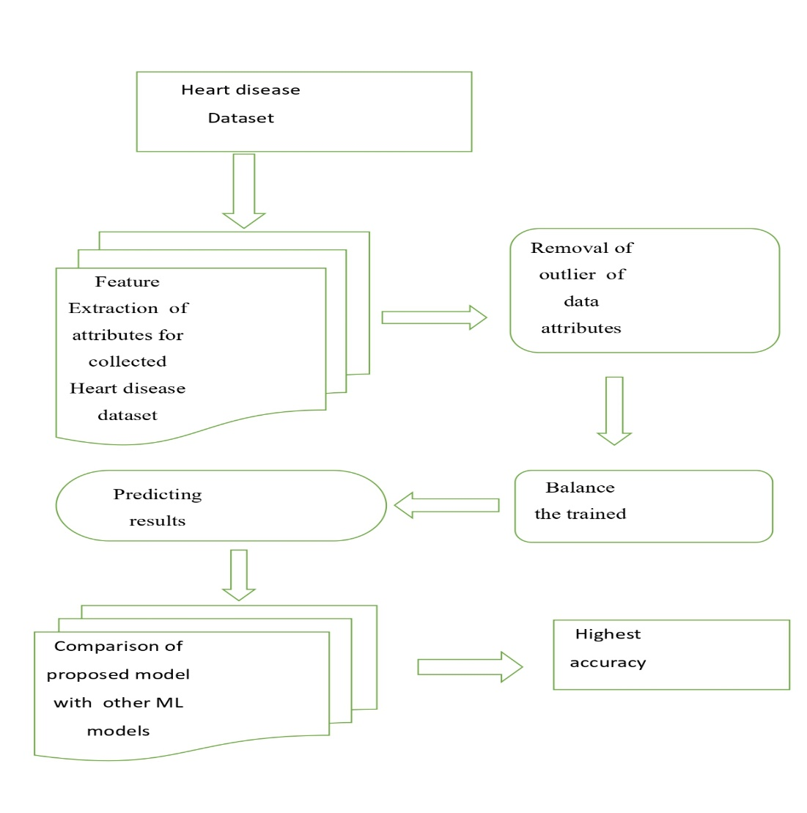
Summary of Methodology / Approach
Fig: Architectural design of the proposed method
6

Slide 7
Description of architecture of Proposed model
Here by using dataset first feature extraction is done by using DBSCAN
Later to balance the attributes of dataset for this SMOTTEENN is used.
For this training and testing will done for dataset.
Finally comparison study will be done to get accurate results for predicting heart disease.
Data Pre-processing step
• Fitting Logistic Regression to the Training set
• Predicting the test result
• Test accuracy of the result(Creation of Confusion matrix)
• Visualizing the test set result.
7

Slide 8
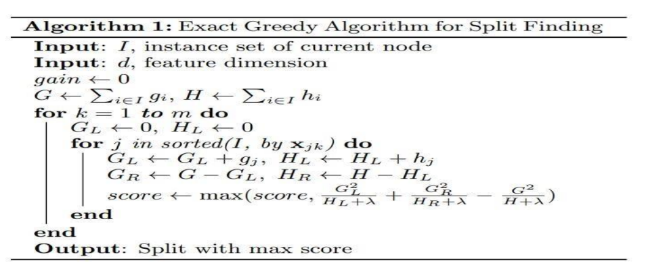
Algorithms involved
Fig :XGBOOST Algorithm
8

Slide 9
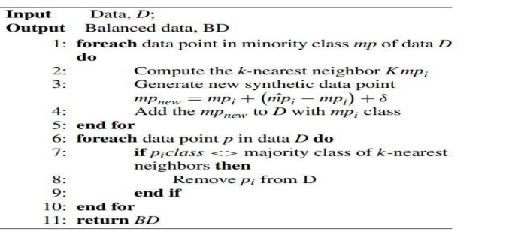
Pseudocode of SMOTEENN
9

Slide 10
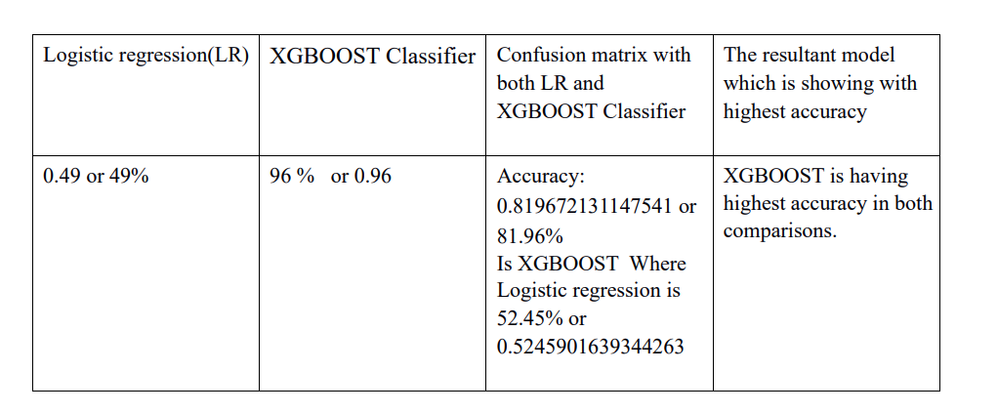
Comparing the accuracies both with confusion matrix and another comparison study
10

Slide 11
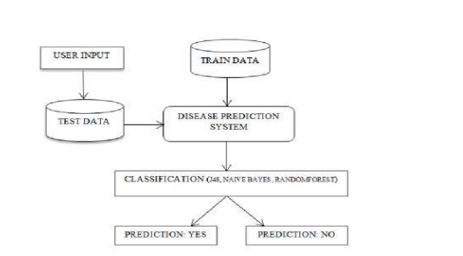
Evaluation of model
Fig :step-by-step procedure of working deploying dataset into the system.
11

Slide 12
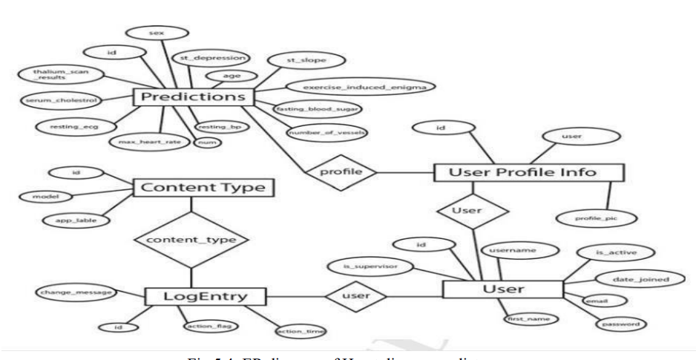
ER diagram of Heart disease predictor
12

Slide 13
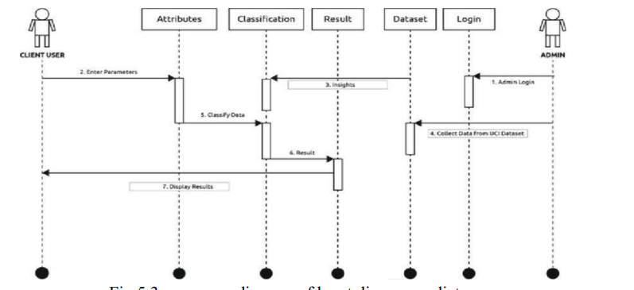
Sequence diagram of heart disease predictor
13

Slide 14
Modules and Implementation Details
Collecting Heart Disease Datasets.
Feature Extraction
Balancing the attributes of dataset
Identifying the disease using attributes
Comparison of ML model with proposed model
Highest percentage will be considered as resultant model
14

Slide 15
Project Demonstration
Exhibit the working demonstration of complete project.
It has to be complete in all aspects
Data set creation needs to be showed wherever applicable.
15

Slide 16
Test Plan and Strategy
In this first Heart disease dataset (Statlog and Cleveland datasets) are collected.
Execution of datasets by implementing ML models i.e., Logistic regression with proposed model (XGBOOST Classifier).
Comparison study is done for both models.
Again both ML models is deployed into the Confusion matrix.
Finally by looking it to the accuracies of models, the highest accuracy model will be considered as resultant model.
16

Slide 17
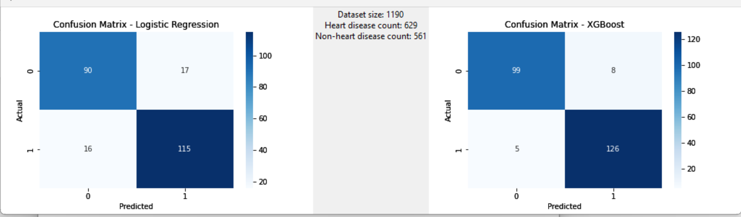
Results and Discussion
17

Slide 18
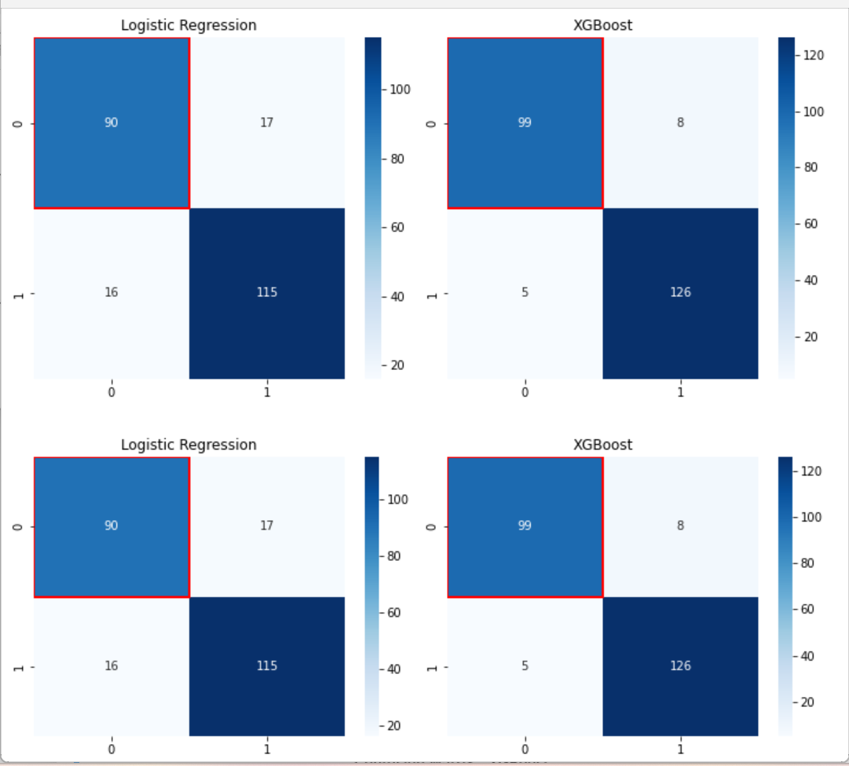
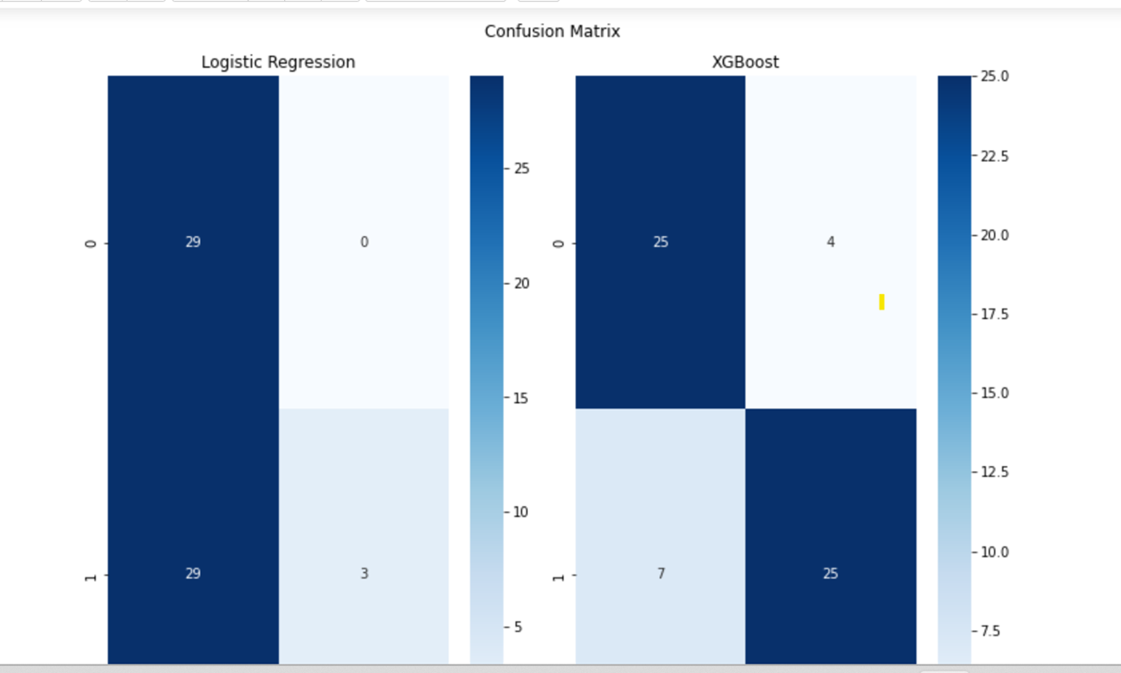
Results
18

Slide 19
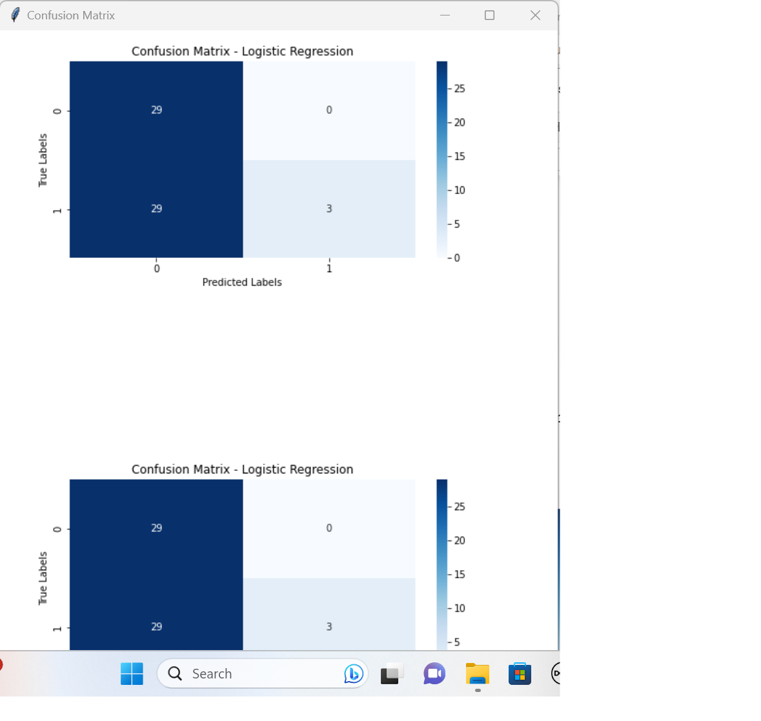
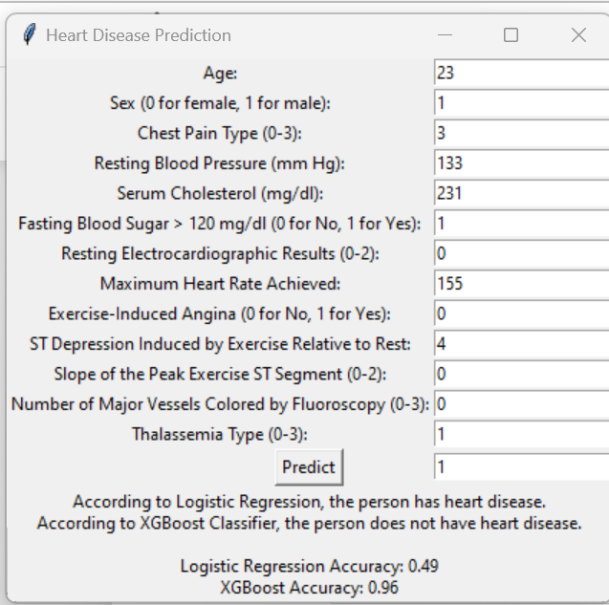
Results
19

Slide 20
Documentation
Show the evidences, status of the below documents:
Project report finalized by Guide?
IEEE (similar) Format of Paper ready for submission or current status? Which Conferences are you targeting? Have you submitted to any conference/journal? List out.
https://github.com/sharada931/M-tech-project-files
A3 size Poster of your project to be shown.
All artifacts of your project uploaded in the CSE Project repository?
20

Slide 21
Lessons Learnt
Removal of outlier of attributes in dataset using DBSCAN.
Balancing the attributes of dataset from overlapping using SMOTEENN.
Comparison of ML models and getting the highest accuracy by deploying in confusion matrix.
Prediction of heart disease using XGBOOST Classifier.
By using GUI the highest accuracy will be predicted with Logistic regression with proposed model , XGBOOST classifier.
21

Slide 22
Conclusion and Future work
After carrying out in this extensive literature survey, findings with respect to review and evaluation are as follows by implemented with proposed model with another model for comparison for predicting heart disease.
Finally getting with accurate result of models. Along with this the able to identifying exactly how many people are having disease and how many are not having through dataset using confusion matrix along with comparison study of proposed model with another.
In further work planning to create web-based app by introducing a web API that predicts heart disease. In this supposed to use Django for the web framework and the form for form validation.
In this it will be having Login Page,Signup page ,Predict Heart Disease Page, Filled Prediction page,Prediction result Page ,About Us Page , Admin Login and Admin dashboard.
22

Slide 23
References
[1] N. L. Fitriyani, M. Syafrudin, G. Alfian and J. Rhee, "HDPM: An Effective Heart Disease Prediction
Model for a Clinical Decision Support System," in IEEE Access, vol. 8, pp. 133034-133050, 2020, doi:
10.1109/ACCESS.2020.3010511.
[2] G. N. Ahmad, H. Fatima, S. Ullah, A. Salah Saidi and Imdadullah, "Efficient Medical Diagnosis of
Human Heart Diseases Using Machine Learning Techniques With and Without GridSearchCV," in IEEE
Access, vol. 10, pp. 80151-80173, 2022, doi: 10.1109/ACCESS.2022.3165792.
[3] D. Bertsimas, L. Mingardi and B. Stellato, "Machine Learning for Real-Time Heart Disease Prediction,"
in IEEE Journal of Biomedical and Health Informatics, vol. 25, no. 9, pp. 3627-3637, Sept.
2021, doi: 10.1109/JBHI.2021.3066347.
[4] J. P. Li, A. U. Haq, S. U. Din, J. Khan, A. Khan and A. Saboor, "Heart Disease Identification Method
Using Machine Learning Classification in E-Healthcare," in IEEE Access, vol. 8, pp. 107562-107582,
2020, doi: 10.1109/ACCESS.2020.3001149.
[5] C. Thirumalai and G. Srivastava, "Effective Heart Disease Prediction Using Hybrid Machine Learning
Techniques," in IEEE Access, vol. 7, pp. 81542-81554, 2019, doi: 10.1109/ACCESS.2019.2923707.
[6] Mythili, T. et al. “A Heart Disease Prediction Model using SVM-Decision Trees-Logistic Regression (SDL).” International Journal of Computer Applications 68 (2013): 11-15.
23

Slide 24
Any other information
Some changes are made in the template like description of architecture of model.
Some extra slides of results like graphs are added.
24

Slide 25
Thank You
25

